Slide 1
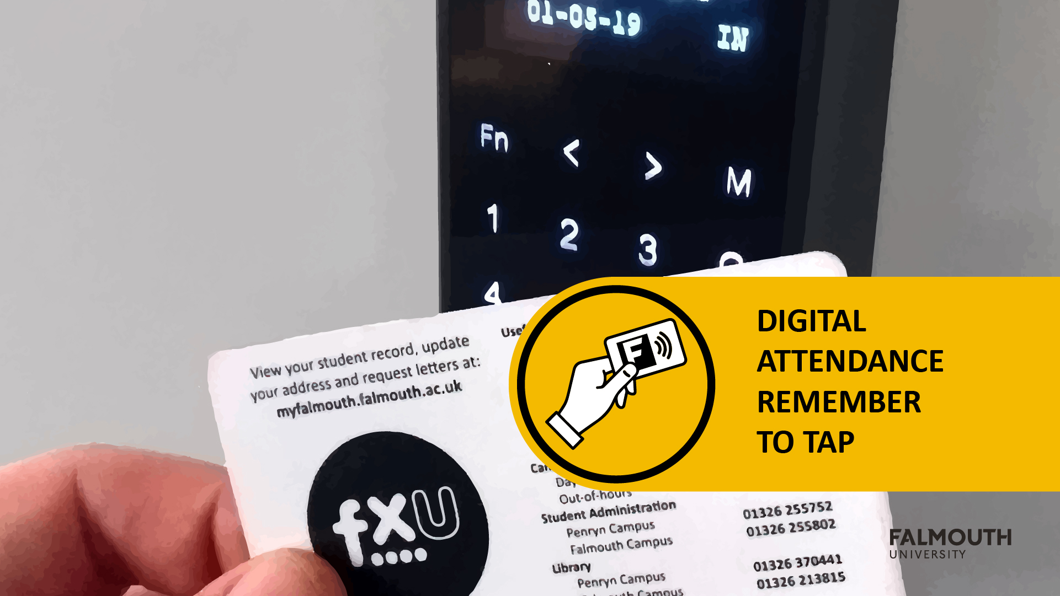

Slide 2


EXPO
Planning

Slide 3
Expo Reminder
Expo will take place from the 4th – 7th of May in the Sports Hall
Monday 4th - Setup Day
Tuesday 5th – Industry/Pitch Day
Wednesday 6th - Games Academy Day
Thursday 7th – Community Day
The Expo will open from 10 – 4 each day, apart from Setup Day where the hall will be open from 9am
There will be a slot for each year to come and do their setup
Please come in as a team and setup
Please sign the register as you enter the hall!

Slide 4
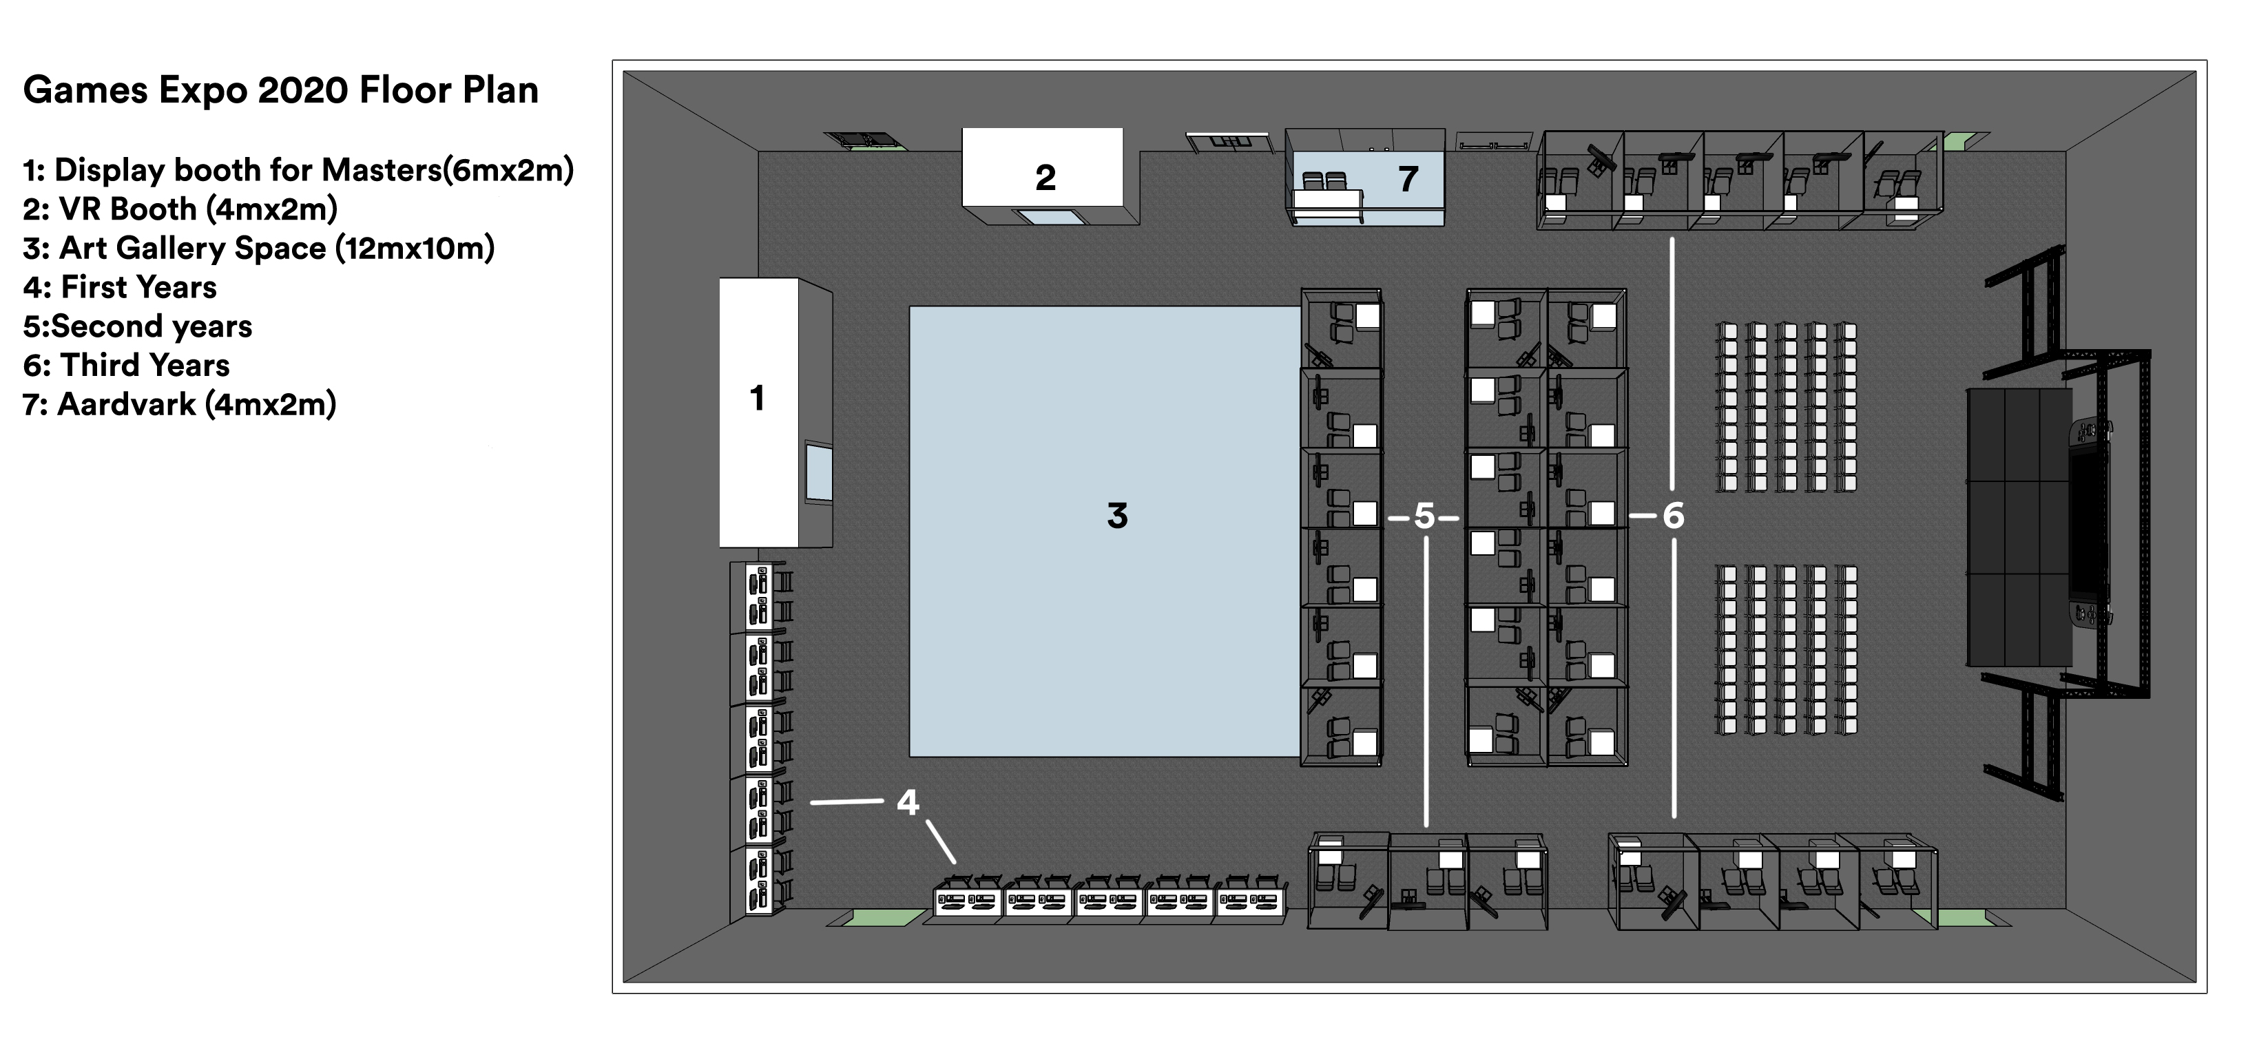
Show Floor

Slide 5
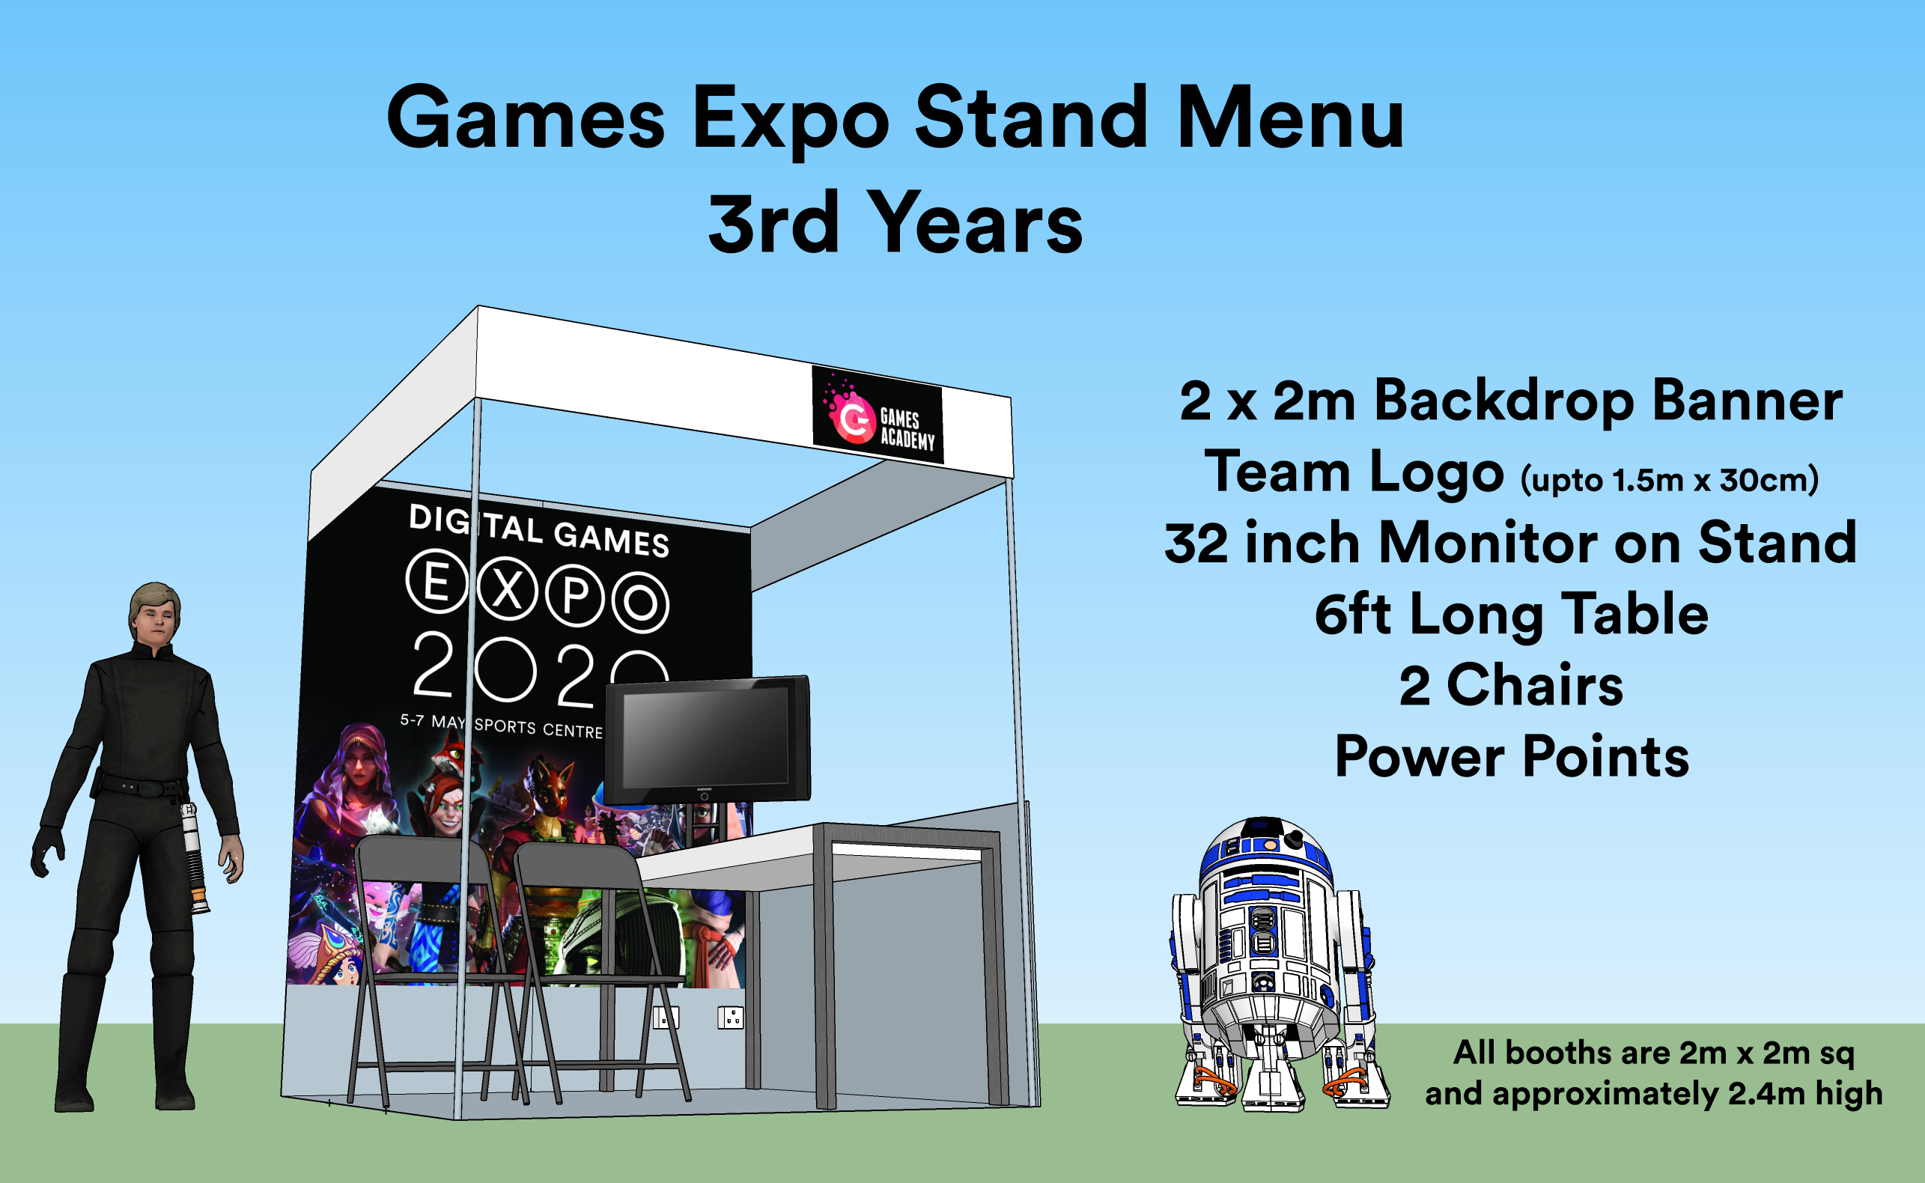
Expo Booth

Slide 6
Expo Requirements
For the expo we are require you to have the following ready:
Game
Game Trailer
Booth Rota
Expo Materials
This is all part of the Studio Practice Assignment for GAM330
See Assignment Brief for details
https://learningspace.falmouth.ac.uk/mod/url/view.php?id=44189

Slide 7
The Game
The game should be in a playable state
Over and above this, the following are suggestions, not requirements:
God mode
Attract mode
Cheat
A special expo build
Ability to restart the game with a keypress

Slide 8
The Game Trailer
This should show the gameplay of your game
The format is up to you
Flashy E3 style trailer
‘Lets’ play style
Traditional gameplay trailer
These will be collected in by the Techs and will be looked by the External Examiner to verify the marking process
So, this should really be a good showcase for your game!

Slide 9
Expo Rota
As a team you decide on a schedule for manning the booth
The rules are:
A minimum of two people need to be there each day
Everyone should take a turn
All team members should be present at some point on the Industry Day & Games Academy day
Everyone should be able to deliver the Elevator Pitch for the game
The Rota should be shown to your Supervisor in advance of the Expo
Please note, you will still need to sign-in for the Expo Day
Those not on the booths should be attending the Expo or taking a break

Slide 10
Expo Materials
These materials will directly impact on the look of your booth, so carefully consider the design of these materials
Banner for the Game – 2m x 2m
Team Logo and Ident – 30cm (tall) x 1.5m (wide)
Various Merch
Game Standee
These materials will need to be printed, so make sure you complete these in plenty of time
In addition, please proofread all materials!
Please note, it is the team's responsibility to design and make these. Please don’t put all the work onto the art team!

Slide 11
Expo Materials – Banner & Ident
These will be mounted on your booth
Please make sure your work is high resolution and high dpi (300 – 600 DPI for print is usual)
Start think about the design of these now, and consider working on a draft in the next Sprint
We are going to order from the following using the GA Credit Card
https://www.printedtoday.co.uk/product/exhibition-backdrop-banners/?gclid=Cj0KCQiApt_xBRDxARIsAAMUMu-KRJ9K96G8VM62iEO1mOpHcQ4VXzH7r-R0ozWpnIWu6Nc_JX6AGPYaAissEALw_wcB

Slide 12
Expo Materials – Merch
You will have a budget of £100
Please use the following website to build up a list of items
https://www.fluidbranding.com/
Please consider sustainability when selecting items
Show a list of items to your supervisor for sign-off
The Games Academy will order this via our account with Fluid Branding

Slide 13
Expo Materials – Game Standees
These small stands will be used to explain your game and the controls
Think of it as a summary that someone would browse on a game box or on a steam/itch.io page
The standee should also feature the game controls, please consider making this easy to read and not just a block of text
Please provide a QR which points to an itch.io page or similar
We will provide a PSD template for this:
https://learningspace.falmouth.ac.uk/mod/resource/view.php?id=60914
The Games Academy will print these for you!

Slide 14

Expo Materials – Game Standees

Slide 15
Expo Materials – Game Standees

Slide 16
Expo Materials – Game Standees

Slide 17
Expo – Final Words
This is a celebration of your work
We want you to have fun. showing off your work
We also want you to play each others game and give feedback
This is going to be a fun event and be a great experience!

Slide 18
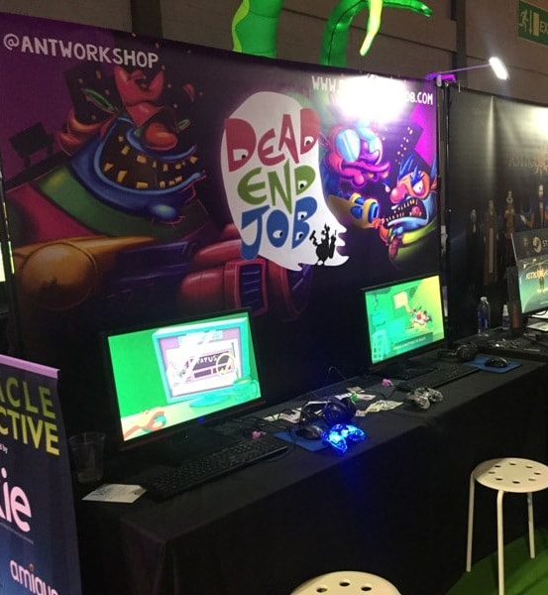
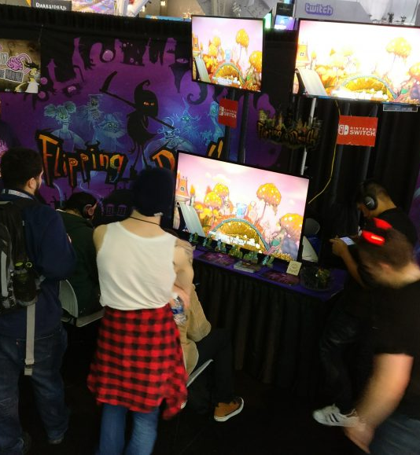

Slide 19
Useful Links
You suck at showcasing your game - https://www.youtube.com/watch?v=gB8CvsOjDvg
Planning a booth at PAX - http://www.zoinkgames.com/plan-convention-booth-pax-east/
How to showcase your Indie Game - https://www.gamasutra.com/blogs/LauraBularca/20160922/281849/How_to_show_your_indie_game_at_any_expo.php

Slide 20
Expo Key Dates
All Expo Materials Supervisor Sign-off – 1700 on 27th of March
T-Shirts – 1700 on 3rd of April
All Expo Materials to be ordered/printed – 1700 on 3rd of April
Game Trailers – 1700 on 27th of April
Expo – 4th of May

Slide 21
Questions?

